Slide 1
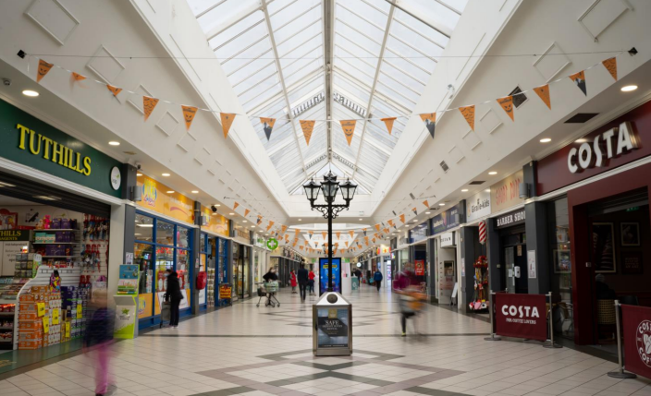
Unit 13, The Mill Shopping Centre, Clondalkin
Unit 13, The Mill Shopping Centre, Clondalkin
To let
Property Highlights
      Excellent retail opportunity within Mill Shopping Centre located in Clondalkin.
      Extending to approximately 136 sq.m. (1,462 sq.ft.) with great frontage onto the shopping mall.
      Quoting rent available on enquiry.
Property Description
The Mill Shopping Centre is located in the heart of Clondalkin and offers an extensive range of quality retail outlets and 800 free parking spaces. The centre extends to just under 100,000 sq ft in total and is anchored by Dunnes Stores. The Mill boasts a host of national and international retailers including Costa, Boots, Lloyds Pharmacy and Specsavers.
Contact
Conor Niland
Email: Conor.Niland@cushwake.com
Tel: +353 1 639 9219

Slide 2
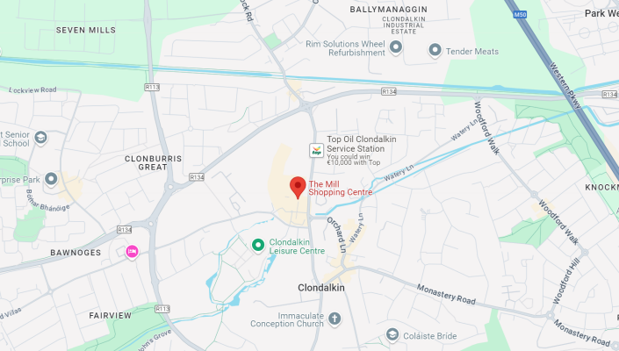
Unit 13, The Mill Shopping Centre, Clondalkin
Location
The Mill Shopping Centre is located on Ninth Lock Road in Clondalkin, Dublin 22, just a few minutes’ walk from Clondalkin Village. The area is a well-established and densely populated west Dublin suburb with strong population growth. The existing population within a 4km drive is approximately 140,000 people, according to the latest Census. The centre also benefits from being less than ten minutes’ drive from the Strategic Development Zones of Clonburris and Adamstown, where significant new housing is planned for an estimated 23,000 people.
Rent
Rent is on application.
Viewings
Strictly by appointment only through sole leasing agents Cushman & Wakefield.
Service Charge
Service Charge for this property is approximately €15,157.78 per annum.
Cushman & Wakefield
2 Cumberland Place Fenian Street Dublin 2
Ireland
+353 (0)1 639 9300
Rates
Commercial rates for this property is approximately €16,615.20 per annum.
Insurance
The insurance is €2,298.94.

